Slide 1
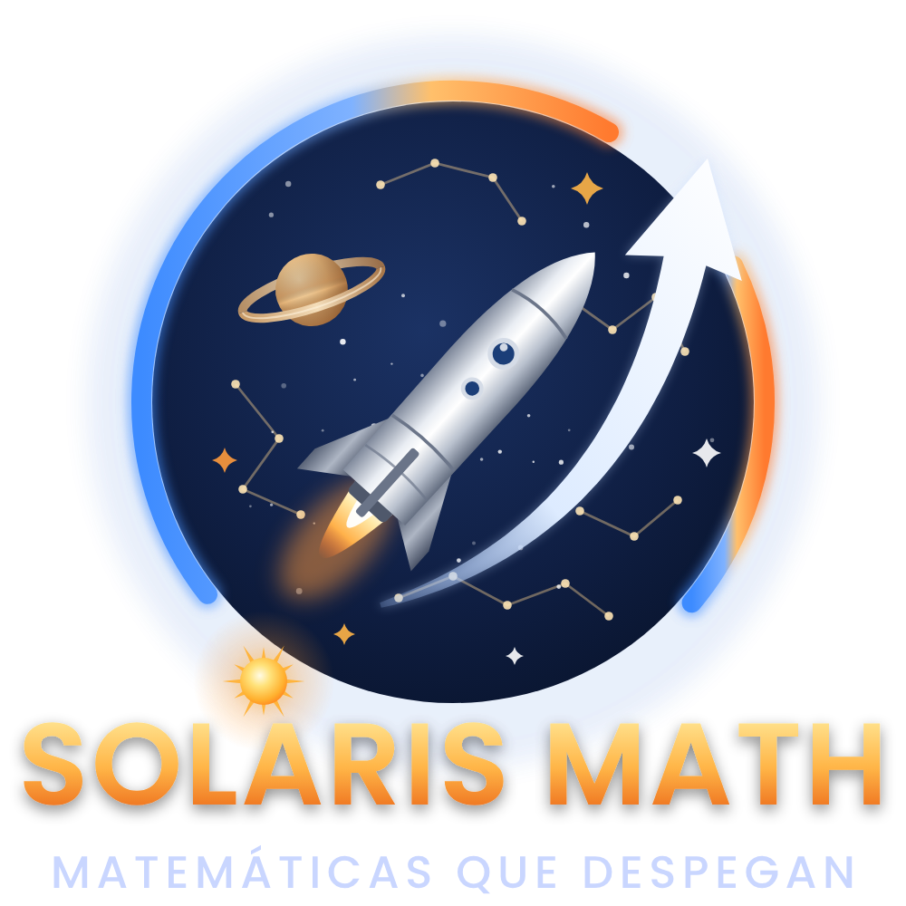
1 / 10 · Welcome
+
∞
π
−
%
√
×
½
Σ
Math from grade 1 to 11, step by step and at your own pace
÷
Notes:
[7.9 s] Welcome to Solaris Math: math that takes off. An app to learn math from first to eleventh grade, step by step and at your own pace.

Slide 2
2 / 10 · In numbers
÷
The whole school in a single app
+
∞
53
π
11
92
∞
−
%
topics from grade 1 to 11
grades, from primary to high school
related Basic Learning Rights (MEN)
exercises: they never repeat
√
×
½
Σ
Notes:
[15.2 s] Solaris Math runs in the browser of any phone or computer, with no ads. It has fifty-three topics, aligned with the national standards and the Basic Learning Rights of Colombia’s Ministry of Education. And its exercises are created on the spot, so they never repeat.

Slide 3
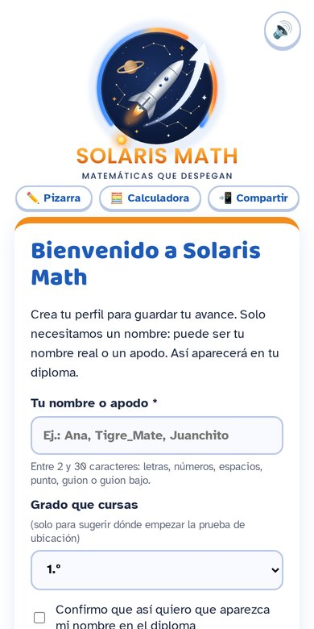
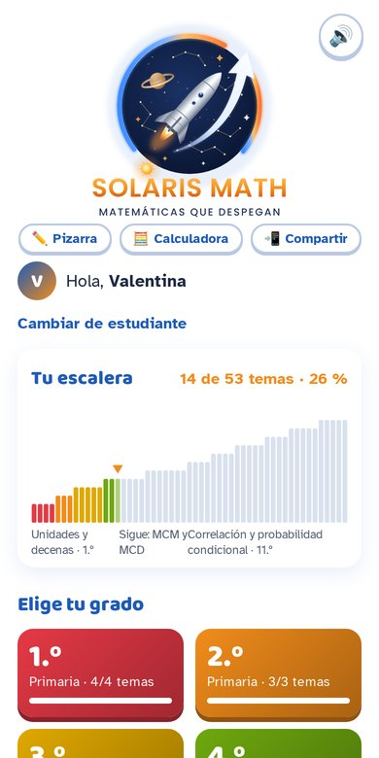
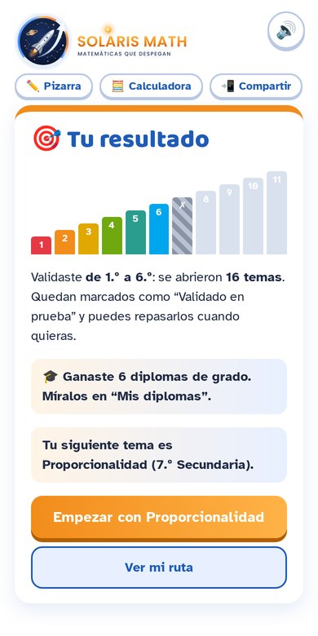




3 / 10 · The staircase
½
Learning is
climbing a staircase
Σ
÷
+
Each student signs in with a nickname
∞
π
Progress is drawn as a colorful staircase
−
Pass with 9 out of 15 to unlock the next topic
%
√
×
A placement test finds each student’s level
Notes:
[14.4 s] Each student creates a profile with just a nickname. Progress is drawn as a staircase: to climb to the next topic, they need nine correct answers out of fifteen. And if they already know the basics, a placement test lets them start at their own level.

Slide 4
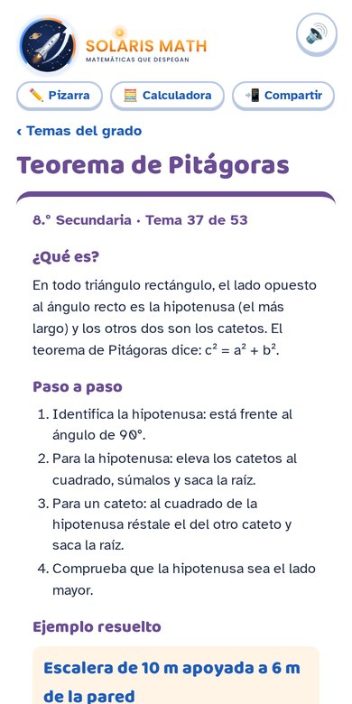
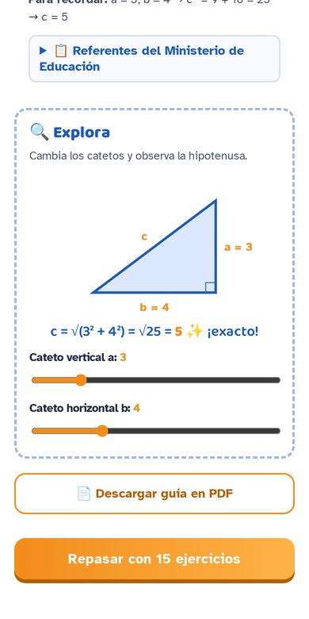
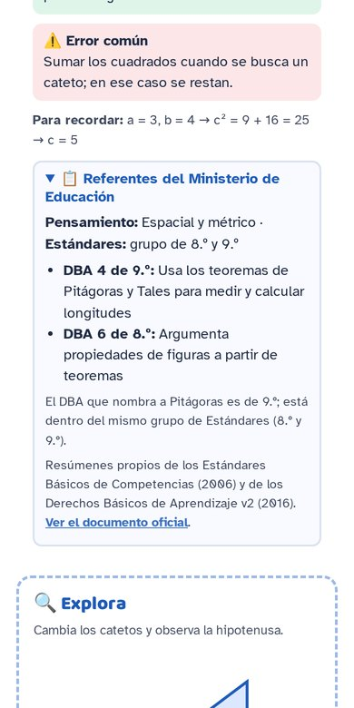



4 / 10 · Every topic
×
First understand,
then practice
½
Σ
÷
+
Five-part lesson: what it is, step by step, example, real life and common mistake
Explore: drawings you move with your finger
∞
π
−
The official curriculum references of each topic
%
√
Notes:
[14.8 s] Each topic starts with a full lesson: what it is, step by step, a worked example, real-life uses, and the most common mistake. The Explore section has interactive drawings to move, rotate and discover. And each topic shows its official curriculum references.

Slide 5
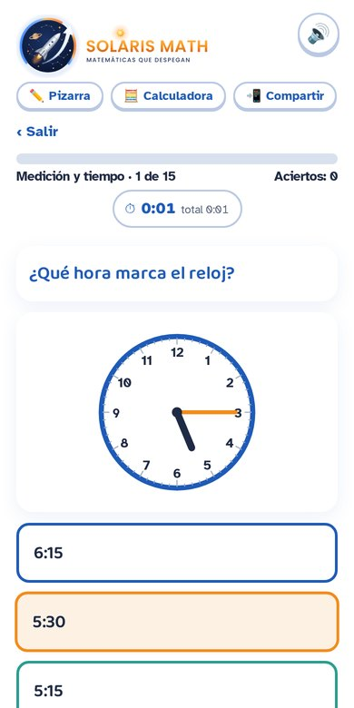
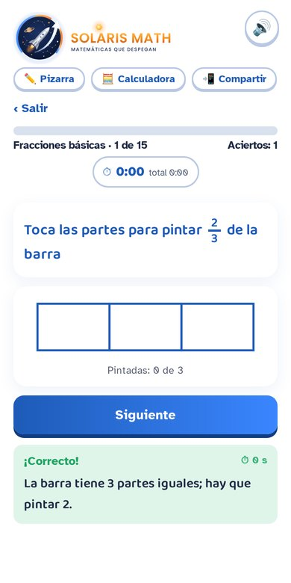
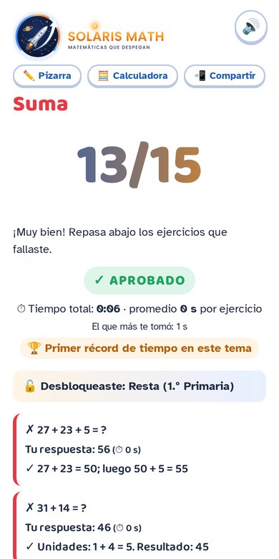


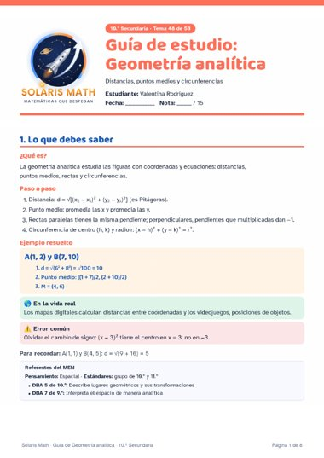


5 / 10 · Practice
%
Fifteen challenges
that teach
√
×
½
Σ
Randomly generated exercises, with drawings to tap and shade
÷
+
Mistakes show the step-by-step solution
∞
Timer, sounds, streaks and records
π
−
A printable PDF guide for every topic
Notes:
[16.1 s] Then come fifteen randomly generated exercises: with numbers, choices, drawings to tap, or fractions to shade. If a student makes a mistake, they see the solution step by step. A timer tracks their time, with sounds, streaks and records. And every topic has a PDF guide to print.

Slide 6
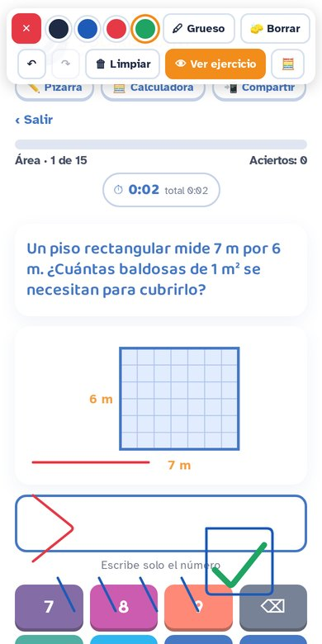
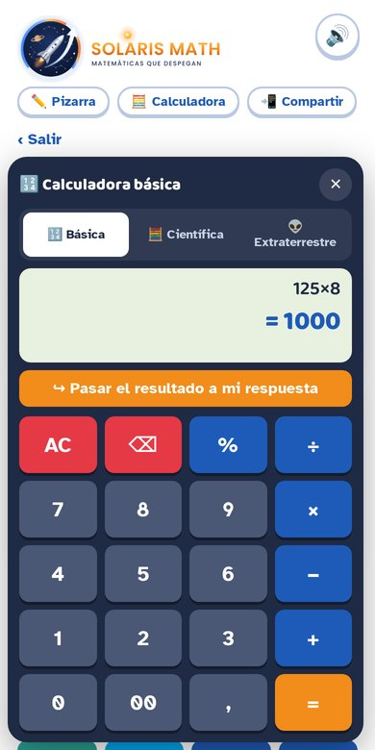
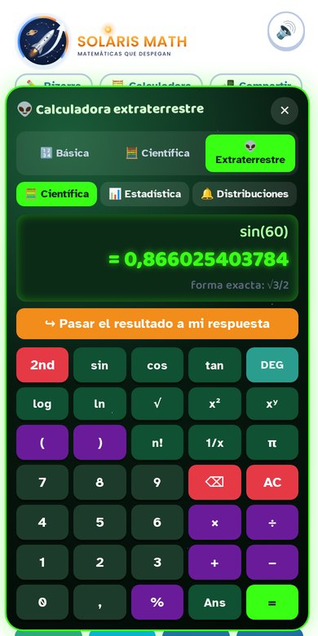



6 / 10 · Tools
Whiteboard and
calculator at hand
%
√
×
Whiteboard: the whole screen becomes a board
½
Σ
A basic calculator for primary school
÷
+
Scientific and… alien 👽
∞
π
−
Notes:
[10.1 s] The tools are right under the logo. The whiteboard turns the screen into a board for working by hand. And the calculator has three levels: basic, scientific… and alien.

Slide 7
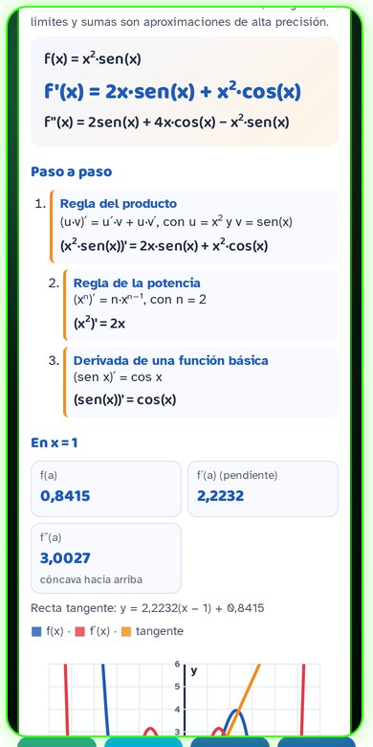
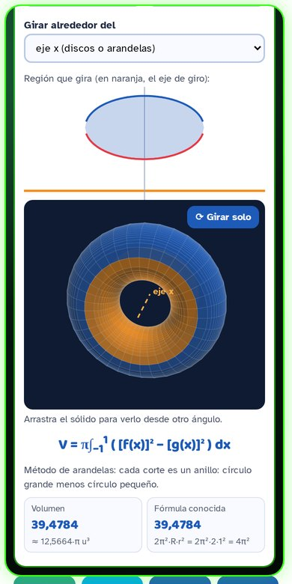




7 / 10 · Alien 👽
π
−
Alien
mode
%
√
×
Derivatives with steps: every rule explained
Graphs with crossings, maximums and minimums
½
Σ
÷
3D solids of revolution
+
Probability with the normal curve
∞
Notes:
[15.3 s] Alien mode finds derivatives, showing every rule. It graphs up to three functions and finds their key points. It draws solids of revolution in three dimensions. And it calculates probabilities with the normal curve, and even solves equations with complex numbers.

Slide 8
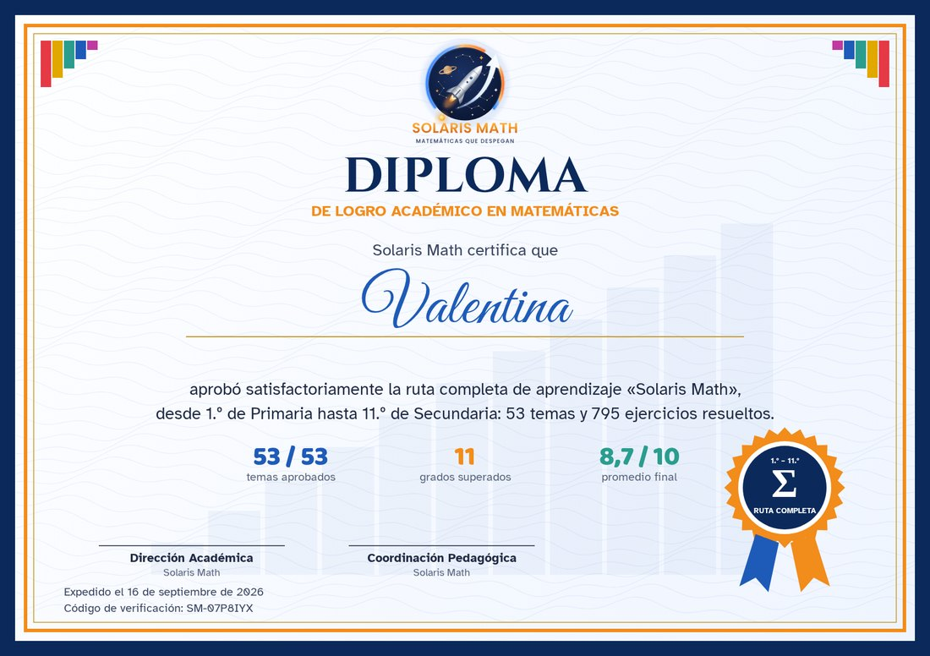



8 / 10 · Diplomas
Every achievement
has a reward
∞
π
−
%
A diploma for every grade, and one for the whole route
√
×
Guides and curriculum alignment for teachers
½
Σ
Optional: class progress in Google Sheets
÷
+
Notes:
[14 s] Every completed grade earns a diploma, and finishing the route earns the final one. Teachers get printable guides and a curriculum alignment report. And if the school wants, a version connected to Google Sheets shows the whole class’s progress.

Slide 9
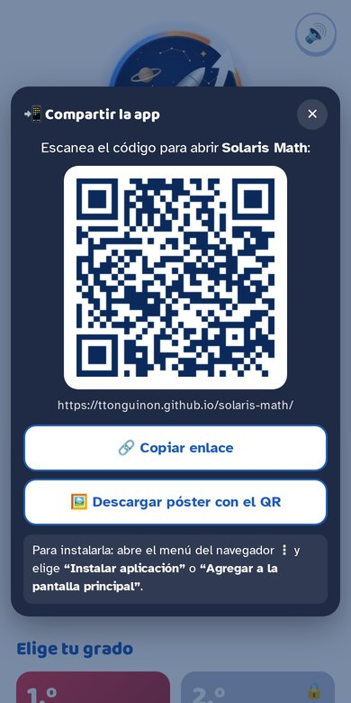




9 / 10 · In class
+
Ready for
the classroom
∞
π
−
Published online for free
%
Shared with a QR code
√
×
Installs and works offline
½
Progress is saved on each device
Σ
÷
Notes:
[8.5 s] It is published online for free, shared with a QR code, and can be installed as an app. It works offline, and progress is saved on each device.

Slide 10
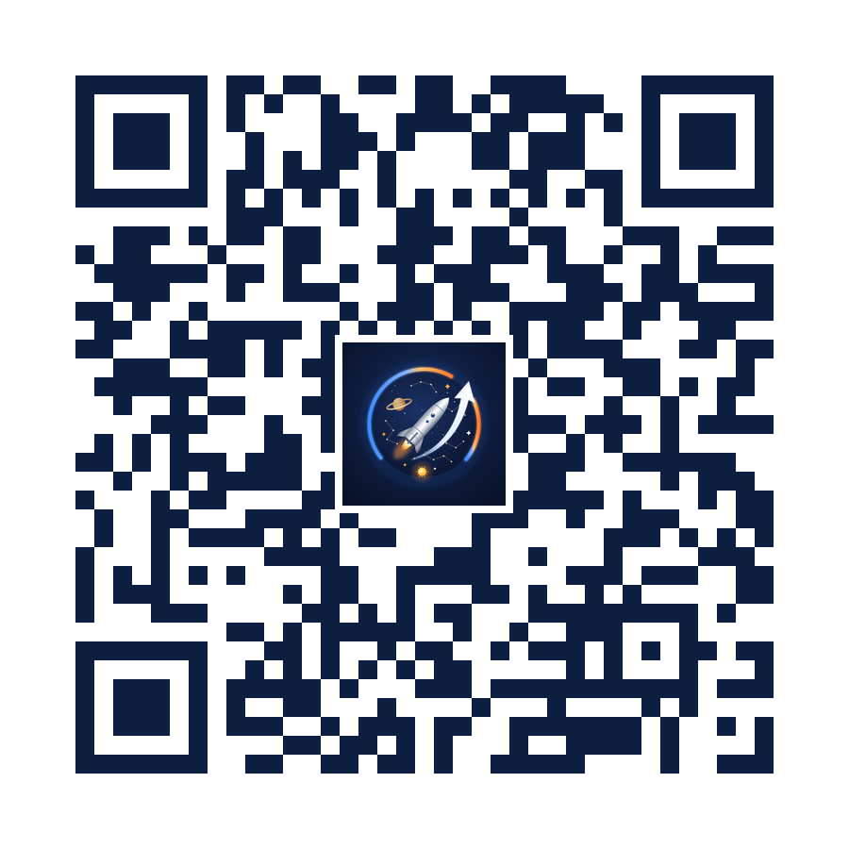
10 / 10 · Let’s begin
Σ
÷
+
∞
π
−
Math that
takes off
%
√
×
Solaris Math
Scan the QR code and start today
ttonguinon.github.io/solaris-math
½
Notes:
[3.7 s] Solaris Math. Math that takes off. Shall we begin?

